Slide 1
Lecture 6:
Informed Search(cont’d)

Slide 2
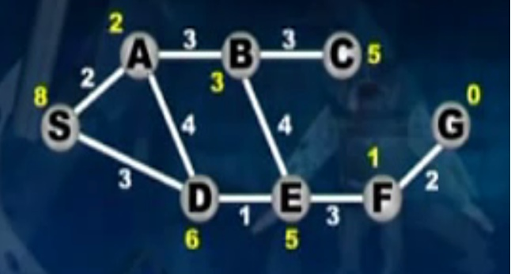
A*

Slide 3
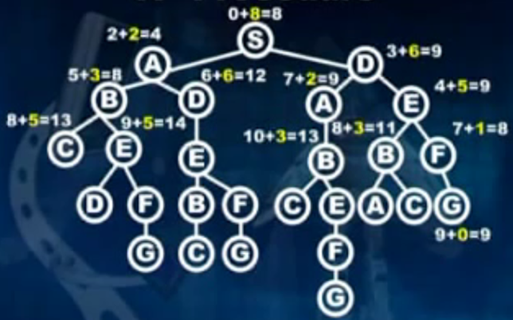
A* ( first under estimate = 8)

Slide 4
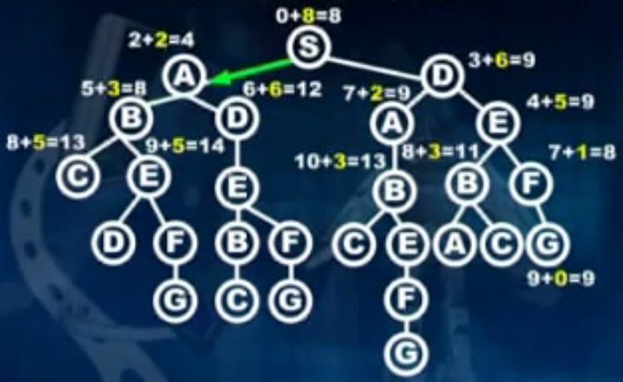
A*

Slide 5
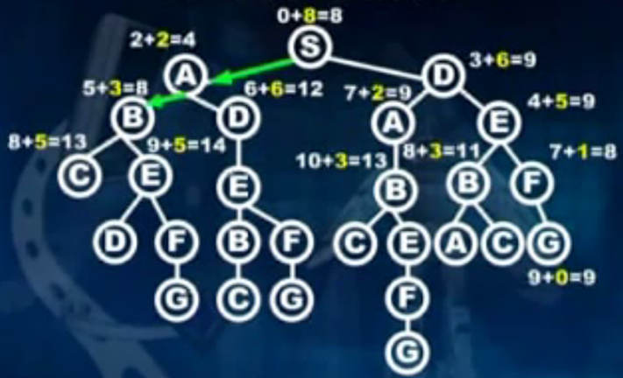
A*

Slide 6
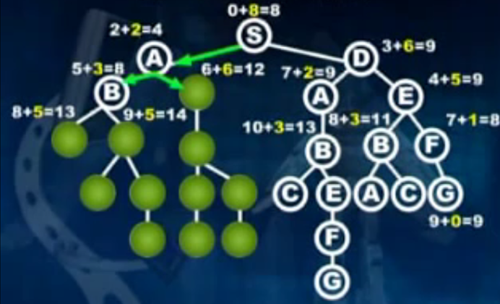
A*

Slide 7
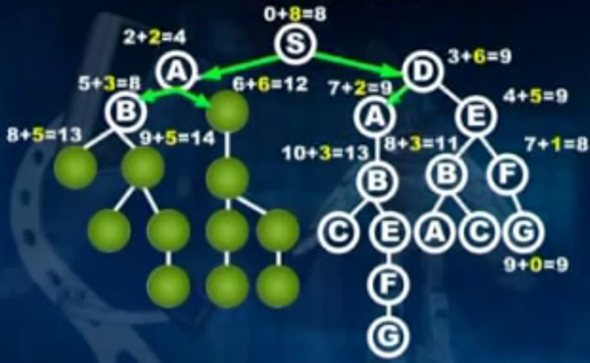
A*

Slide 8
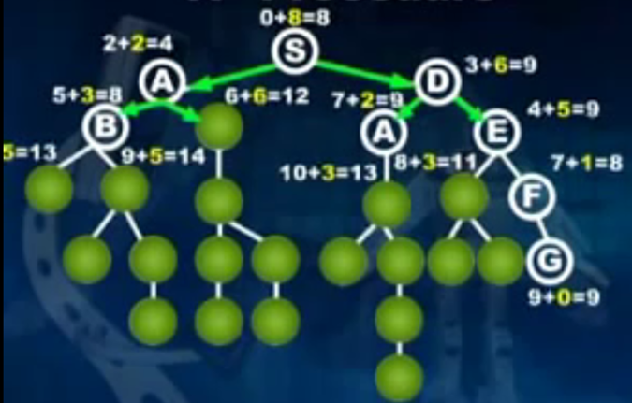
A*

Slide 9
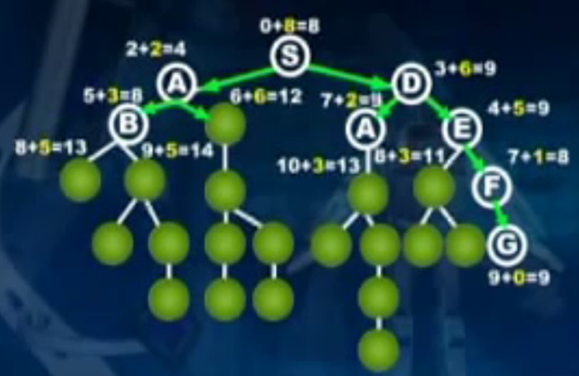
A*

Slide 10
A* search, evaluation
Completeness: YES
Time complexity:
Number of nodes expanded is still exponential in the length of the solution.

Slide 11
A* search, evaluation
Completeness: YES
Time complexity: (exponential with path length)
Space complexity:
It keeps all generated nodes in memory
Hence space is the major problem not time

Slide 12
A* search, evaluation
Completeness: YES
Time complexity: (exponential with path length)
Space complexity:(all nodes are stored)
Optimality: YES
Cannot expand f_{i+1} until f_{i} is finished.
A* expands all nodes with f(n)< C*
A* expands some nodes with f(n)=C*
A* expands no nodes with f(n)>C*
Also optimally efficient (not including ties)

Slide 13
A*- Example
Goal: find a minimum sum-cost path
Notation:
g^(n) = cost of current path from start to node n in the search tree.
h^(n) = estimate of the cheapest cost of a path from n to a goal.
Special evaluation function: f = g+h
f(n) estimates the cheapest cost solution path that goes through n.
h(n) is the true cheapest cost from n to a goal.
g(n) is the true shortest path from the start s, to n.
If the heuristic function, h^, always underestimate the true cost (h^(n) is smaller than h(n)), then A* is guaranteed to find an optimal solution.

Slide 14
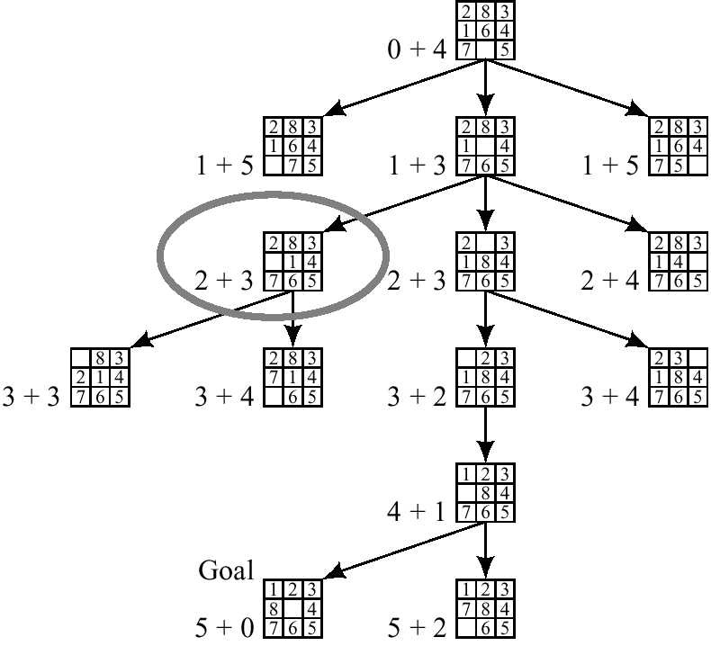
A* on 8-puzzle with h(n) = w(n)

Slide 15
1
4
A
B
C
2
S
2
5
G
5
3
2
4
D
E
F
A
10.4
B
C
6.7
4.0
11.0
G
S
8.9
3.0
6.9
D
E
F

Slide 16
Example of A* Algorithm in action
S
5 + 8.9 = 13.9
2 +10.4 = 12.4
A
D
3 + 6.7 = 9.7
B
D
4 + 8.9 = 12.9
7 + 4 = 11
8 + 6.9 = 14.9
C
E
E
6 + 6.9 = 12.9
Dead End
B
F
10 + 3.0 = 13
11 + 6.7 = 17.7
G
13 + 0 = 13

Slide 17
